Slide 1


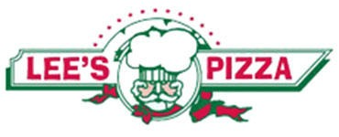

Exploratory Data Analysis Project
Nov 2021
Lee’s Pizza - NYC Market Entry
Prepared by: Li Sun

Slide 2


Introduction
Motivation -
Lee’s Pizza is a brick & mortar pizza store that serves pizza late night.
They’ve always been interested in opening a store in Manhattan to cater to the evening & late night nightlife party crowd.
Lee’s pizza is only interested opening a grab-and-go store (no delivery) in Manhattan Neighborhood but not interested in tourist areas (e.g Times Square)
Problem -
Lee’s Pizza doesn’t know much about NYC and hires Li Sun to provide answers to the following questions:
What Manhattan neighborhood(s) should Lee’s open to maximize pizza sales?
Should they expand beyond their normal hours of operation (8pm-4am)?
Due to the impact of Covid Pandemic, should they enter NYC in 2021?
Goal – Analyze MTA Data to answer the three questions
Notes:
An application program interface (API) is a piece of software code that allows two software programs to communicate with each other
APIs connect business processes, services, content and data to customers, staff and developers in an easy and secure way making it possible to easily connect differing sources of data
External APIs improve connectivity to the world, while internal APIs enable the enterprise to operate more efficiently
They are the digital glue in the digital value chain, powering mobile and web apps, connecting disparate systems, and enabling innovation

Slide 3
Methodology - What Manhattan neighborhood(s) should Lee’s Pizza considering opening?
Methodology –
Use MTA Subway Turnstile data of subway stations located in each of the target Manhattan neighborhoods to gauge foot traffic of potential pizza buyers
Potential customers are Nightlife Partiers, who’s hungry for slices of pizza
5 Target Neighborhoods based on Manhattan Nightlife Establishment Density (e.g. Bars, Clubs, see Appendix)
East Village & West Village
Hell’s Kitchen
Kips Bay & Kips Bay
Gramercy Park
Compare Foot traffic against # of competitor late night pizza stores in each target neighborhood
Assumptions
Majority of late night traffic of potential late night pizza buyers (NightLife partiers) takes the subway
Majority of nightlife partier party in more than one neighborhood per night
Healthy conversion rate of foot traffic to Pizza sales
Data – 15 weeks of 2019 MTA Turnstile Data (July 02 – Oct 30, 2019)
Metrics –
Total Foot Traffic (Entry + Exit) per target neighborhood
Total Competitors / Target Neighborhood
Foot Traffic / Competitor – desire is highest foot traffic, lowest competitor
Notes:
An application program interface (API) is a piece of software code that allows two software programs to communicate with each other
APIs connect business processes, services, content and data to customers, staff and developers in an easy and secure way making it possible to easily connect differing sources of data
External APIs improve connectivity to the world, while internal APIs enable the enterprise to operate more efficiently
They are the digital glue in the digital value chain, powering mobile and web apps, connecting disparate systems, and enabling innovation

Slide 4
Methodology - Should Lee’s expand beyond their normal hours of operation?
Methodology –
Use MTA data to conduct a times series of the average Foot Traffic / station in the Targeted Neighborhoods.
Data – 15 weeks of 2019 MTA Turnstile Data (July 02 – Oct 30, 2019)
Metrics –
Foot Traffic / 4 Hour Block of Time
Notes:
An application program interface (API) is a piece of software code that allows two software programs to communicate with each other
APIs connect business processes, services, content and data to customers, staff and developers in an easy and secure way making it possible to easily connect differing sources of data
External APIs improve connectivity to the world, while internal APIs enable the enterprise to operate more efficiently
They are the digital glue in the digital value chain, powering mobile and web apps, connecting disparate systems, and enabling innovation

Slide 5
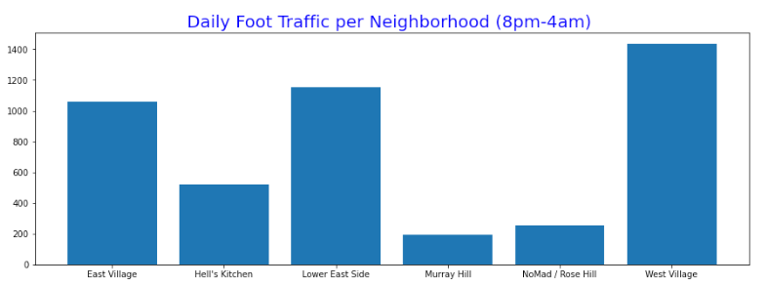
Results – Neighborhood(s)
The
Neighborhood | Daily Foot_Traffic (8pm-4am) | Competitors | Foot Traffic / Competitor
East Village | 1,056 | 7 | 151
Hell's Kitchen | 520 | 5 | 104
Lower East Side | 1,153 | 9 | 128
Murray Hill | 192 | 3 | 64
NoMad / Rose Hill | 252 | 1 | 252
West Village | 1,436 | 5 | 287
Notes:
An application program interface (API) is a piece of software code that allows two software programs to communicate with each other
APIs connect business processes, services, content and data to customers, staff and developers in an easy and secure way making it possible to easily connect differing sources of data
External APIs improve connectivity to the world, while internal APIs enable the enterprise to operate more efficiently
They are the digital glue in the digital value chain, powering mobile and web apps, connecting disparate systems, and enabling innovation

Slide 6
Results
Throughout human history, third party intermediaries (e.g. banks, insurance companies, financial institutions) broker the “trust” between two parties who wants to do business but do not trust each other.
Notes:
An application program interface (API) is a piece of software code that allows two software programs to communicate with each other
APIs connect business processes, services, content and data to customers, staff and developers in an easy and secure way making it possible to easily connect differing sources of data
External APIs improve connectivity to the world, while internal APIs enable the enterprise to operate more efficiently
They are the digital glue in the digital value chain, powering mobile and web apps, connecting disparate systems, and enabling innovation

Slide 7
Results
Notes:
An application program interface (API) is a piece of software code that allows two software programs to communicate with each other
APIs connect business processes, services, content and data to customers, staff and developers in an easy and secure way making it possible to easily connect differing sources of data
External APIs improve connectivity to the world, while internal APIs enable the enterprise to operate more efficiently
They are the digital glue in the digital value chain, powering mobile and web apps, connecting disparate systems, and enabling innovation

Slide 8
Appendix

Slide 9
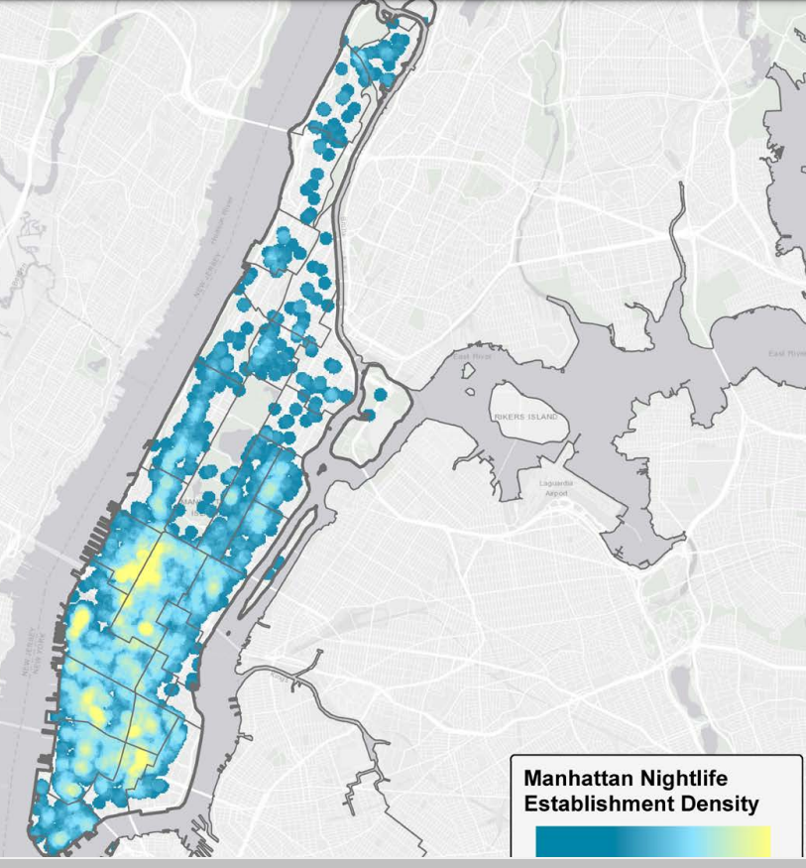
Appendix 1 – Manhattan Nightlife Establishment Density
https://www1.nyc.gov/assets/mome/pdf/ESI-NYCEDC-Nightlife-Report-2018.pdf
Notes:
An application program interface (API) is a piece of software code that allows two software programs to communicate with each other
APIs connect business processes, services, content and data to customers, staff and developers in an easy and secure way making it possible to easily connect differing sources of data
External APIs improve connectivity to the world, while internal APIs enable the enterprise to operate more efficiently
They are the digital glue in the digital value chain, powering mobile and web apps, connecting disparate systems, and enabling innovation

